Slide 1
Patrick Cummins
January 30, 2019

Slide 2
Project Tasks
Compile a comprehensive database of information on the fleet of fossil-fired EGUs in 13-Western states (circa 2014-2017) that contains information on the plants operating characteristics and emissions; and
Develop a projection of 2028 EGU emissions that incorporates expected plant closures, fuel switching, and additional controls required under a “rules on the books” scenario.

Slide 3
2014 to 2017 Data Review Questions
Review data for your state/company and provide any corrections.
The 2014 data will be used in WRAP’s baseline modeling exercise
Flag any data that is not representative of the unit’s current operations – especially in terms of capacity factor (gross load) or emissions rate.
Is the 2017 emissions rate reflective of current (or soon to be installed) controls for NOx and/or SO2 at each unit. If new controls were installed in 2017 that are not fully reflected in that year’s data, or if there are new controls in 2018 or 2019, please describe those controls, note the timing of their installation/operation, and provide a best estimate of the unit’s emission rate once the new controls are fully operational.
Flag any units that switched from coal to gas during 2014-2017 and the date of that switch, or any units that may switch fuel sometime between now and 2028.
The 2014-2017 data will be used to construct a representative profile of each unit’s current operation, both in terms of capacity factor and emissions rate.

Slide 4
Responses to Data Review Received From:
APS
AZ DEQ
Basin
Black Hills
Great River Energy
MDU
Minnkota
MT DEQ
NV DEP
OR DEQ
Otter Tail
PacifiCorp
Platte River
PSCo
SRP
TEP and UNS
Tri-State
WA Ecology

Slide 5
Highlights from Data Review
2014-17 CAMD data is accurate
Respondents identified a number of EGUs that are not in the CAMD data base due to size, age, or other reasons. In many cases, data for these units was provided.
Years with outages, overhauls, or which are not representative for other reasons were identified by respondents.
All the information provided in response to these two questions will be included in the final project report.
Are there any concerns about attributing responses to individual respondents?
Current controls (2017-19) not fully reflected in 2017 data were identified and incorporated into the analysis, along with units that have switched from coal to natural gas.
We will review the resulting emission profiles on this call.

Slide 6
Caveats
Analysis to date addresses coal units only. We will discuss how best to proceed with analysis and projections for the fleet of natural gas generators.
ID and CA – no coal units; WA and OR – no coal units in 2028
2018 data will soon be available and will be reviewed to ensure any important updates are incorporated.
Analysis is limited to NOx and SO2 emissions, with a primary emphasis on NOx emissions.
Western coal units are mostly well-controlled for SO2
When asked why he robbed banks, Willie replied,
“I rob banks because that’s where the money is.”

Slide 7
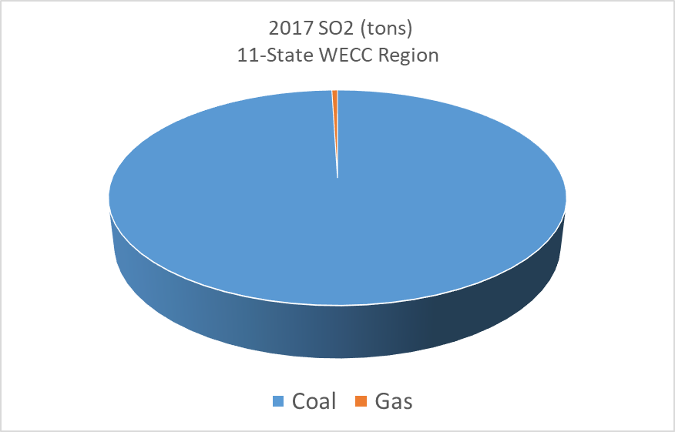
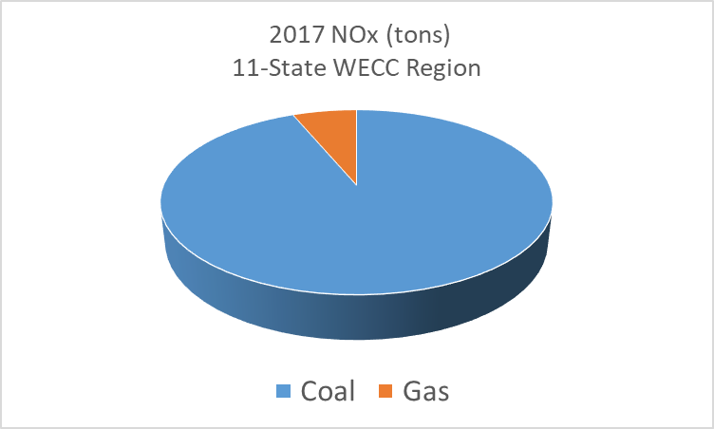
Western Power Sector Emissions of SO2 & NOx: Coal v. Gas
6%

Slide 8
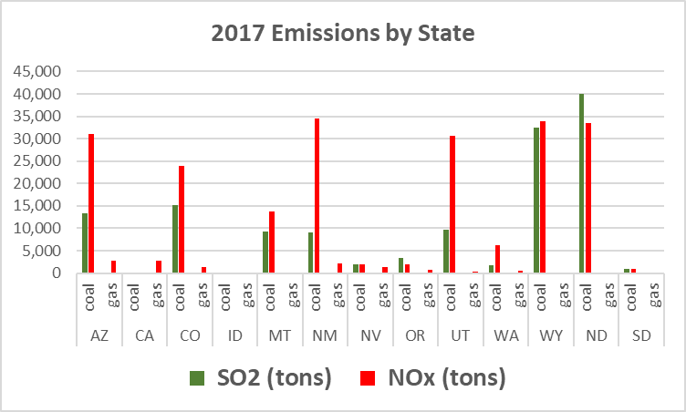
Western Power Sector Emissions

Slide 9
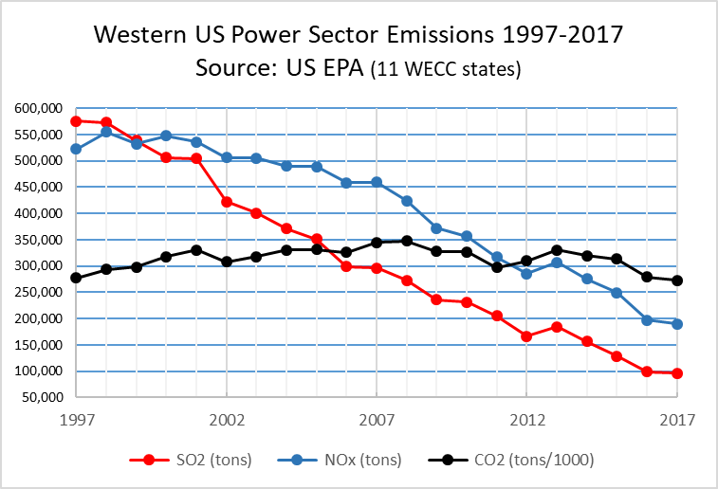
SO2: -83% NOX: -64% CO2: -2% (-22% since 2008)

Slide 10
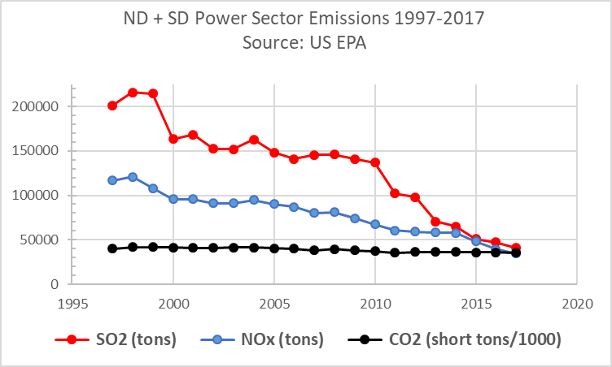
SO2: -80% NOX: -70% CO2: -11% (-10% since 2008)

Slide 13
REVIEW “PLANNED RETIREMENTS” SPREADSHEET

Slide 16
Factors influencing future generation and power sector emissions in the West
Coal unit retirements / additional pollution controls
Capacity factors – coal and gas units
Gas prices
New gas units
Nuclear retirement (Diablo Canyon (CA) – 2024-25)
Hydro variability
Cost of Renewables / federal tax policy for renewables
State climate and energy policies
Energy efficiency / demand-side management programs
Electrification (esp. transportation)
Transmission capacity / additions
Regional wholesale electricity markets (EIM, day-ahead, ISO / RTO)
Energy storage technologies and costs
Grid modernization
Federal energy and environmental policy
Utility IRPs
Corporate and city renewable energy and sustainability goals

Slide 17
“It's tough to make predictions, especially about the future.” ― Yogi Berra

Slide 18
A proposed framing for 2028
Modeling/predicting total generation and the generation mix on the Western grid in 2028 is beyond the scope of this project.
Luckily, that’s not our responsibility.
Our job is to provide a realistic estimate of unit-by-unit emissions under an “on-the-books” scenario to evaluate regional haze impacts.
Scenario 1 provided here = 85% nameplate capacity factor for coal units
Captures the potential impact on the clean days of most concern
Remaining units may see higher capacity factors with so many coal plants retiring
A reasonable screening scenario. Assumptions can be modified if more a detailed evaluation of impacts and controls is required.
We will review this scenario and discuss other options you may want to consider

Slide 19
Methodology
Nameplate Capacity x 8760 hrs x 0.85 = MWhrs
Heat Rate = mmbtu/kWh
Emission rate = lbs/mmbtu
Apply proper conversion factors (e.g., 2000 lbs = 1 ton)
Then: MWhrs x Heat Rate x Emission Rate = Tons Per Year

Slide 20
Review Unit Level Data Files

Slide 21
Discuss next steps & March 12 Workshop
Any changes to assumptions regarding planned coal unit retirements?
Other 2028 Scenarios that should be considered for the coal units?
How should we project emissions from existing gas generation?
Should we include and new gas units?
…….
Discuss March 12 workshop agenda and objectives
Phase II of this project

